Slide 1
Fractal Tic-Tac-Toe
Evelyn Drollinger-Smith, Dawson Wright

Slide 2
Idea Generation
Idea originated from Evelyn, daughter really likes fractal tic-tac-toe and this project could be used as an app for her to play.
Worked very well for the project, good way to demonstrate object-oriented design principles.

Slide 3
Original Code
Dawson wrote the original draft for the code to be able to start with an extremely simple app.
Problems: only had 2 classes, and didn’t show good inheritance. Also displayed only in the terminal and did not have a very intuitive UI.

Slide 4
Updated Code
Evelyn was able to convert the original app into the updated code we have now.
Used a composite pattern in order to divide the main board from nine “big boards” that all have 9 “small boards” inside of them.
Uses a template pattern by utilizing an abstract draw() method in order to visualize the board.
Also leans into making the game system Model-View-Controller.
Model: Board, Square — contain the game state and logic.
View: draw() methods in Board, Square, and Fractal.
Controller: handle_mouse_click() and make_move() in Fractal.

Slide 5
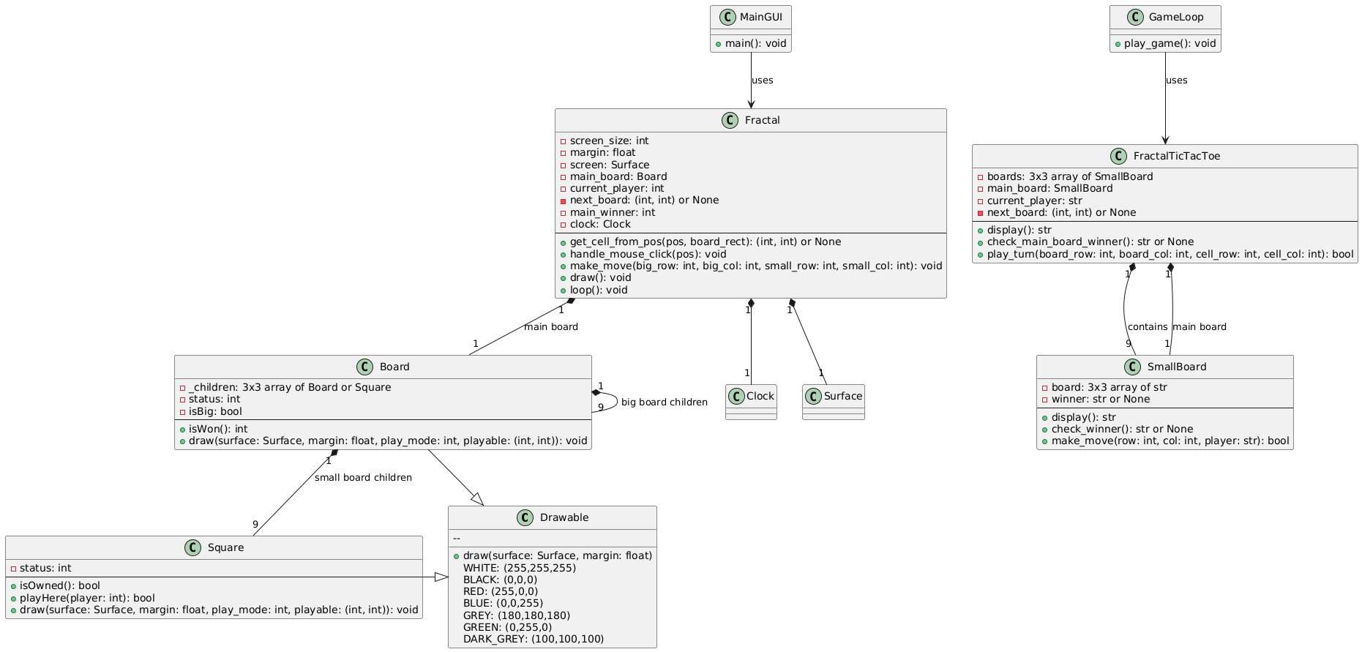
Final UML

